Slide 1
Arduino Session 12
Continue the IR Receiver
SPI Protocol Part 1 of 4
Arduino as SPI Master (sending data only)

Slide 2
Continuing the IR Receiver
We will continue in the tinkercad

Slide 3
How Communications are Organized
The communication between devices falls into these categories
Supervised
All Communications are managed by a master (possibly multiple)
Every other device other than master are called slaves
Slaves can’t initiate communication, they only obey master requests
Unsupervised
Communications are managed by a convention, or managed by a hub devices (though the hub is not a master)
Any devices can contact any other devices and send whatever data they want
Any devices is free to reply with whatever they want

Slide 4
Types of Network Connections (How devices are connected)
There are many types of network topologies, we will see the most common one in consumer electronics and the most common one in embedded devices (e.g. Arduino)

Slide 5
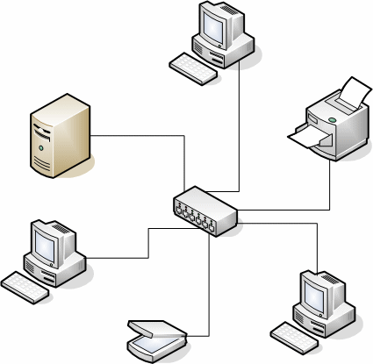
Star Topology
Usually (especially in consumer electronics) in star communication the central device is not a master (although it can be)
If any device wants to perform any of communication, the device needs to contact the hub with the desired data and the meta-data required for data re-routing

Slide 6
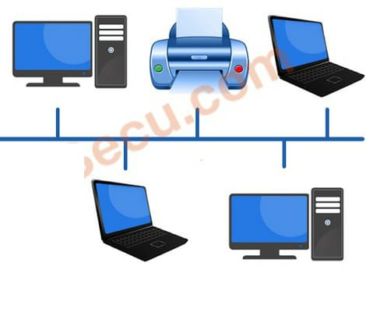
Common Bus Topology
Usually in embedded system (like the Arduino, cars electronics, smartphones internally), there is at least one master, where the whole system works for the master (like how 4G chip, radio chip, camera module, roughly speaking serve the CPU)
The Common Bus Topology supports multiple masters
The master may act as an organizer only but still a have full control over the bus

Slide 7
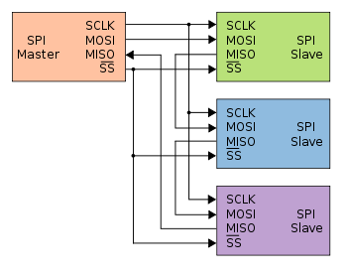
Serial Peripheral Interface
In Arduino practically we connect at most one or two devices
The common bus consist of “MasterOutSlaveIn”, “MasterInSlaveOut”, “SerialClock”

Slide 8
Serial Peripheral Interface
As there is MISO & MOSI lines then the SPI protocol is full-duplex
As of the SCLK the SPI protocol is synchronous
The SPI protocol doesn’t have in-data package addressing, for selectivity the “SlaveSelect” line is activated with the target slave

Slide 9
Pros & Cons of SPI
Search online for why to use SPI, any why not
ETC: 5min

Slide 10
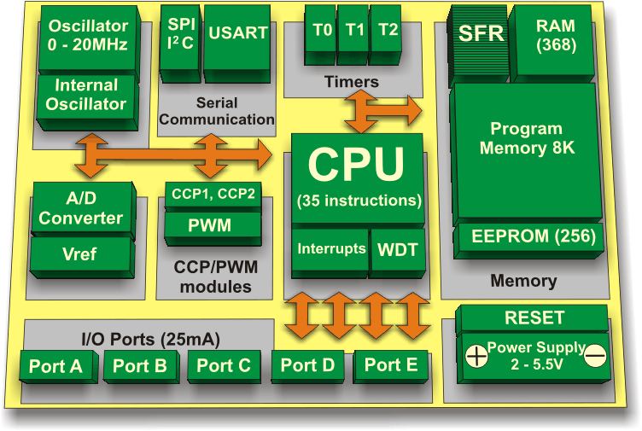
How is SPI device is embedded inside a microcontroller
The control registers of the SPI device are exposed to the CPU
These control registers, determine how the SPI will behave, like will it be master or slave, clock speed, …
But the most recognizable register is the SPI Buffer (it is called “SPDR”, if you are interested)

Slide 11
How to use SPI registers & Buffer
In Master Mode just as we access the I/O port register through beginner-friendly commands, we will see these commands shortly in the tinkercad, for now we will see the master aspect of the SPI device.
However, in order to know how to fill the SPI parameters (thinks of it like pinMode for I/O ports, but extended) we need to call the initializer function of the SPI library
Regarding the buffers, they are available so that the Arduino, is not overwhelmed with the speed of any external communication bus, or the frequency of receiving the data

Slide 12
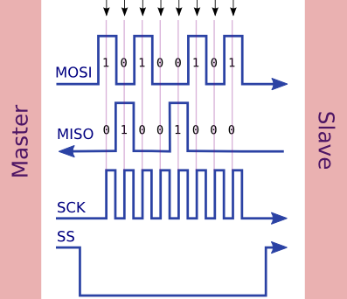
How to send Data using SPI
We pull the SS line of the desired slave to “LOW”
We initiate the SPI device with appropriate setting
We fill the “SPI Buffer” with desired data to be sent
Data sending is done either when requested by the Arduino, or the SPI device is terminated
We pull the SS line of the desired slave back to “HIGH”
Data is sent on the “MOSI” line with synchronous with the “SCLK” line

Slide 13
How to Control a Dummy Slave Arduino
Open tinkercad, use the link I will share with you to copy the Arduino code ONLY, then create you own sketch and paste the dummy code into it
Our configuration: Arduino as master, default setting for speed and mode of operation, only sending data over MISO, MOSI line is not activated

Slide 14
SPI setting
The parameters of the communication are dependent only on the master, or need to be agreed on between devices
The most significant parameter are:
“ClockDivider” controls the speed of the SPI data bus
“SPIMode” controls the Method of data interruption
Other less significant parameters:
“OrderOfSending”
“SPIInterrupt”

